Slide 1
Neural Networks
By: Aayush Kubba

Slide 2
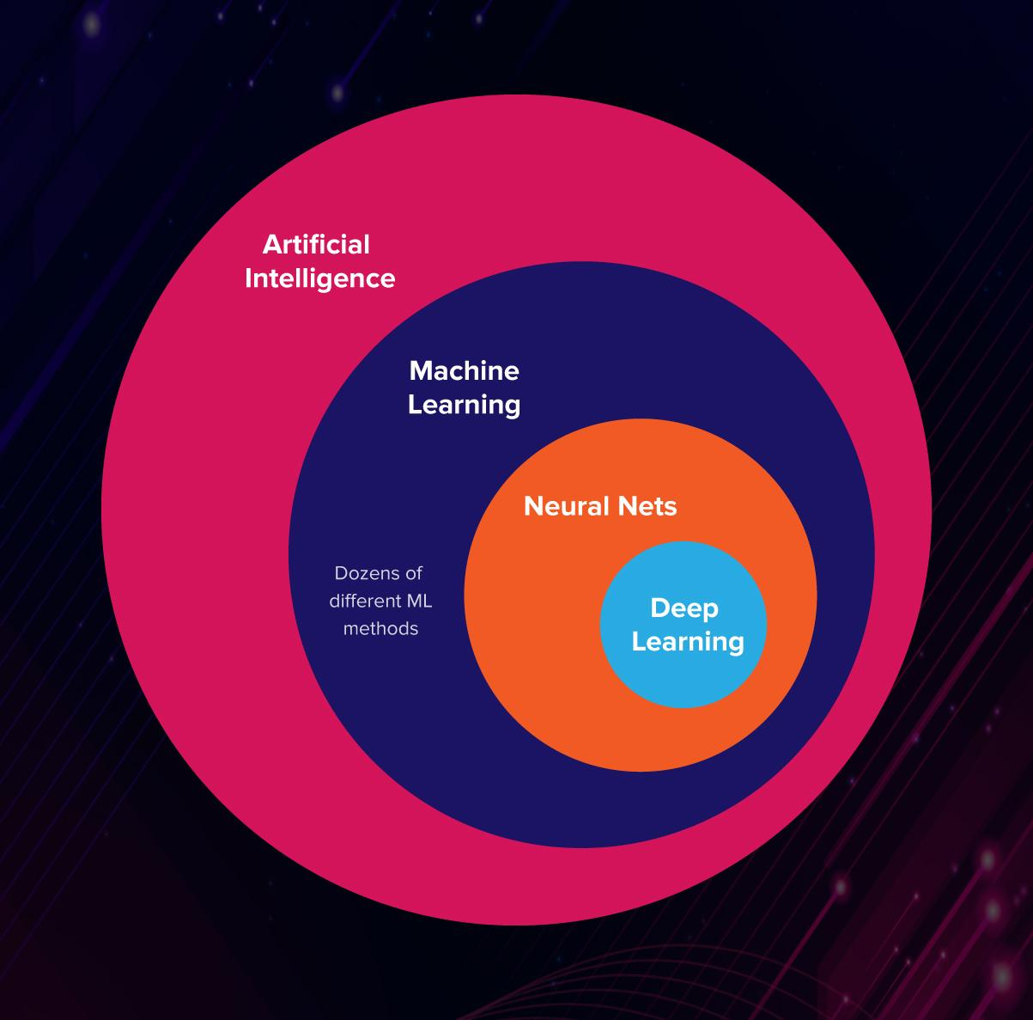
Demystifying AI

Slide 3
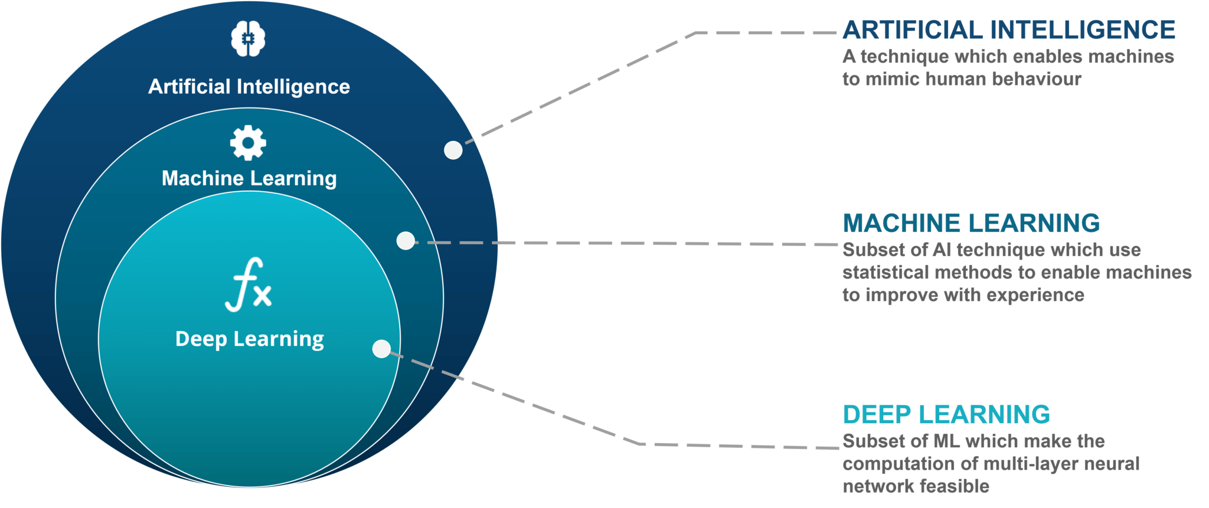
AI - Explained

Slide 4
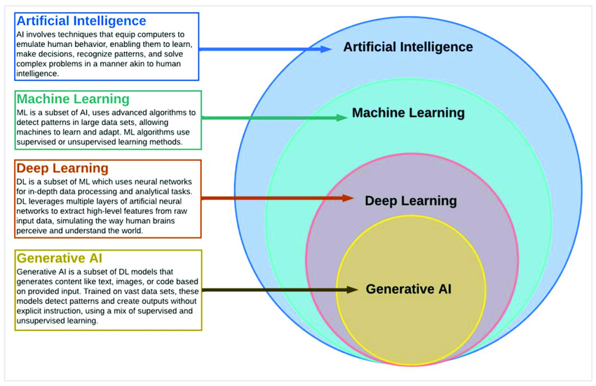

Slide 5
What is ML
Think about writing a code for Rock, Paper and Scissor
Make rules look at pixels, make decision based on rules
Code rules
Instead:
Show a machine many images and tell them the label for them and let machine learn.

Slide 6
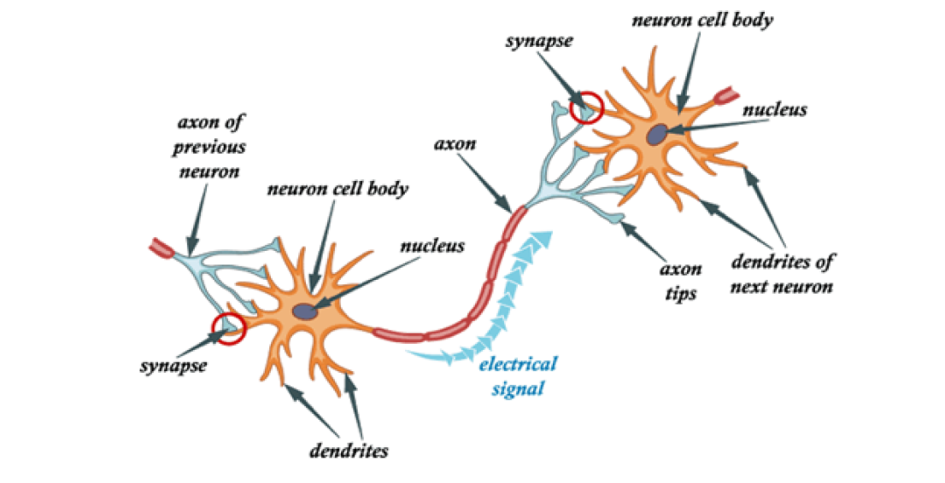
What is Deep Learning
Deep learning is a subfield of machine learning that structures algorithms in layers to create an "artificial neural network” that can learn and make intelligent decisions on its own.
Neural networks form the base of deep learning, which is a subfield of machine learning, where
The structure of the human brain inspires the algorithms.

Slide 7

ML VS DL
While basic machine learning models do become progressively better at whatever their function is, they still need some guidance.
If an AI algorithm returns an inaccurate prediction, then an engineer has to step in and make adjustments.
With a deep learning model, an algorithm can determine on its own if a prediction is accurate or not through its own neural network.

Slide 8
How does deep learning work?
A deep learning model is designed to continually analyze data with a logic structure similar to how a human would draw conclusions.
To achieve this, artificial neural network.
Inspired by the biological neural network of the human brain
Leading to a process of learning that’s far more capable than that of standard machine learning models.
Requires lots of training to get the learning processes correct
Google’s AlphaGo.
Google created a computer program with its own neural network that learned to play the abstract board game called Go, which is known for requiring sharp intellect and intuition. B

Slide 9

What is a Neural Network?

Slide 10
What is a Neural Network?
Neural network is also known as an Artificial Neural Network
It is a type of machine learning algorithm that is inspired by the biological brain
It is one of many popular algorithms that is used within the world of machine learning
Its goal is to solve problems in a similar way as the human brain does
Neural network is a part of what’s called deep learning

Slide 11
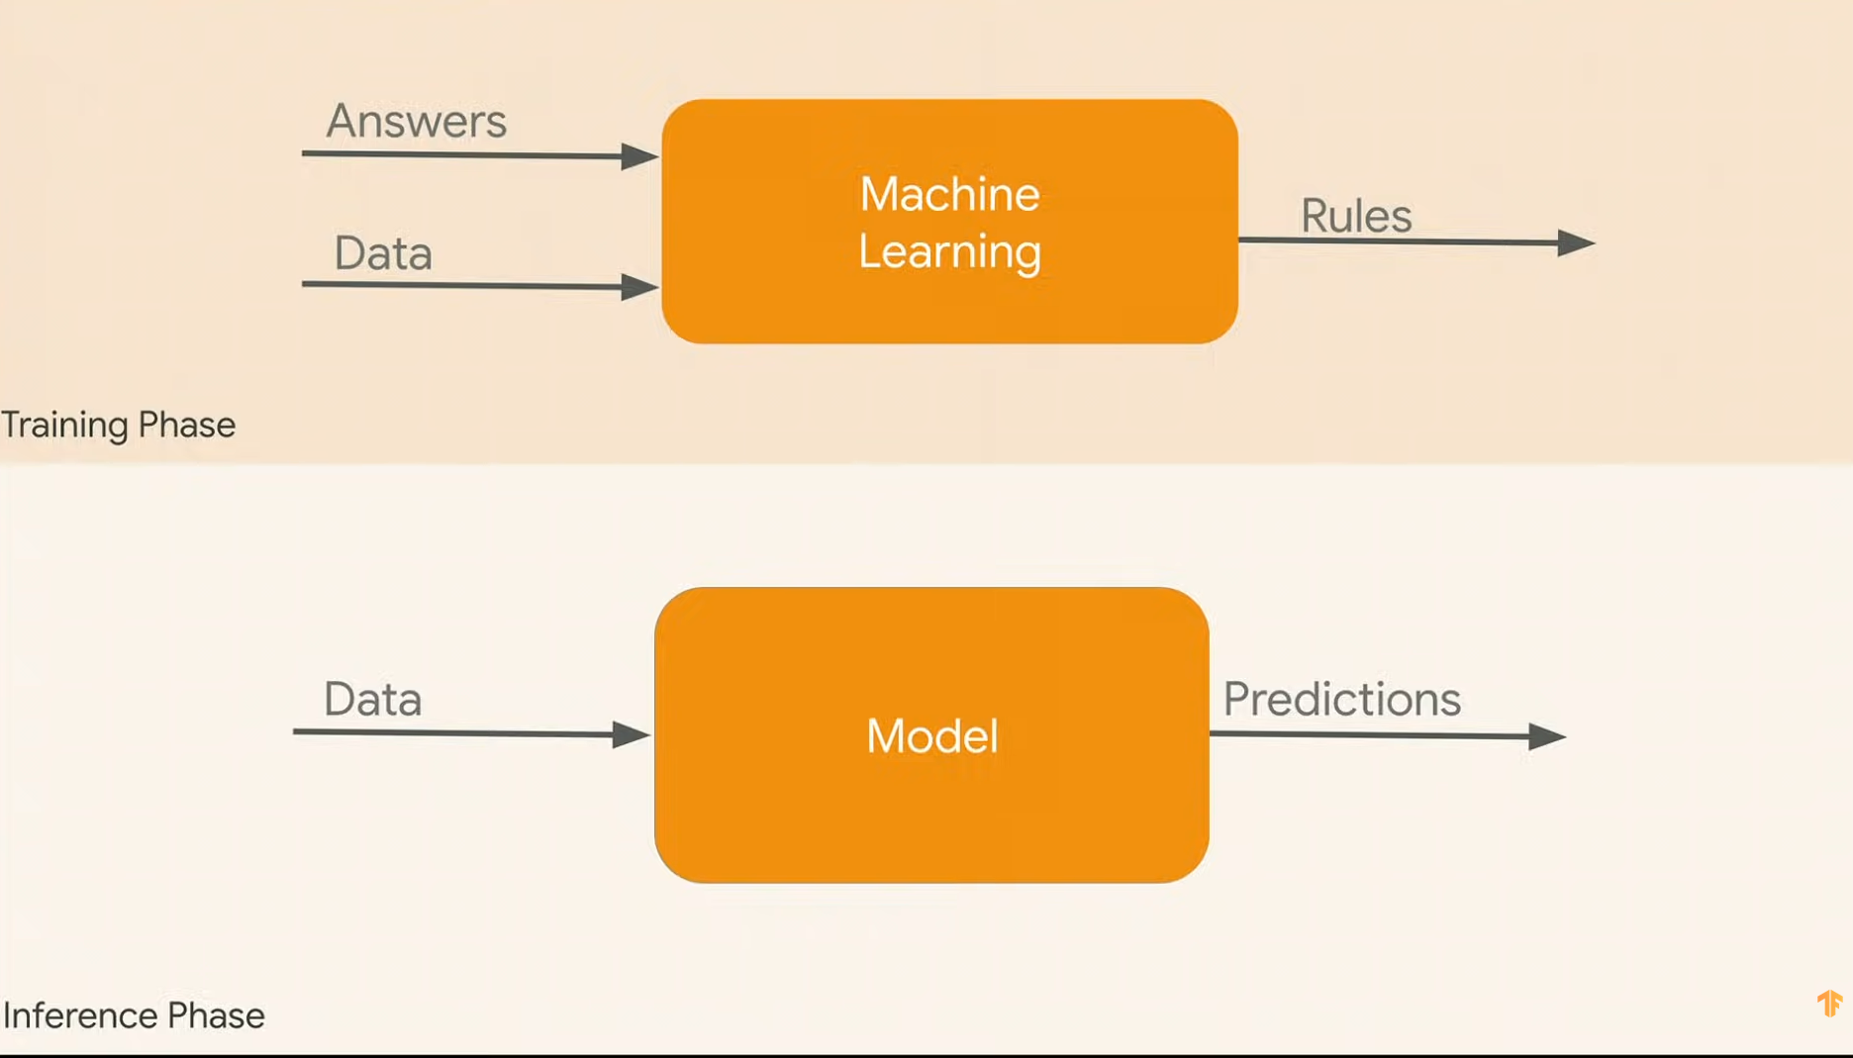
Intuition

Slide 12
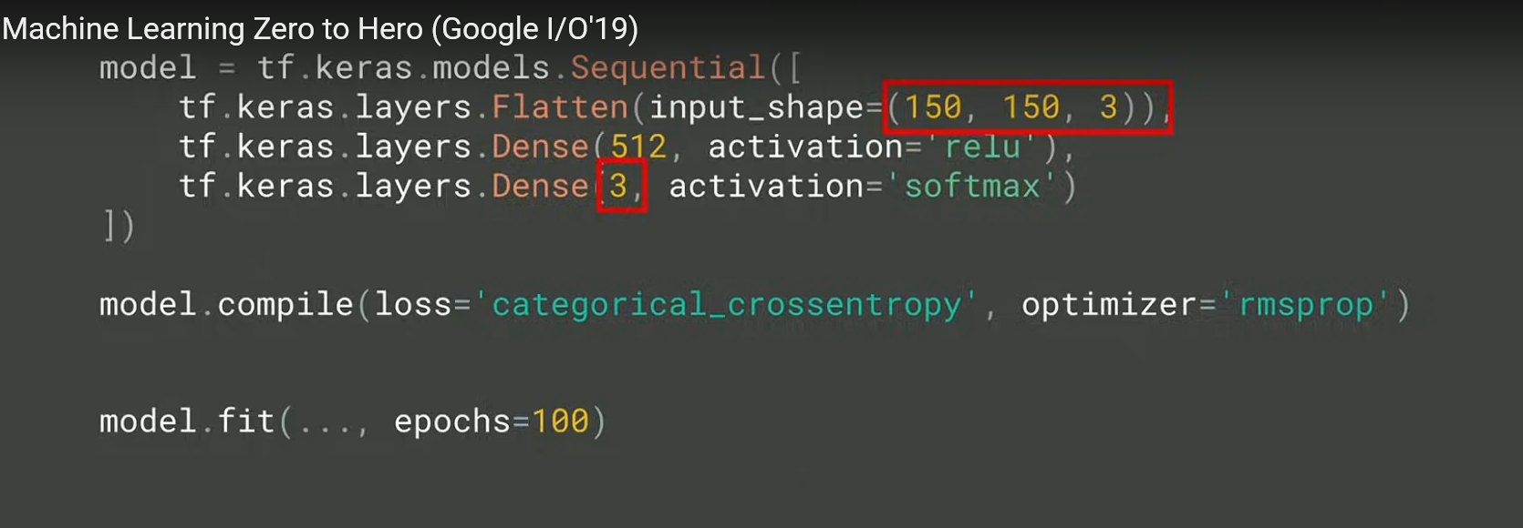

Slide 13
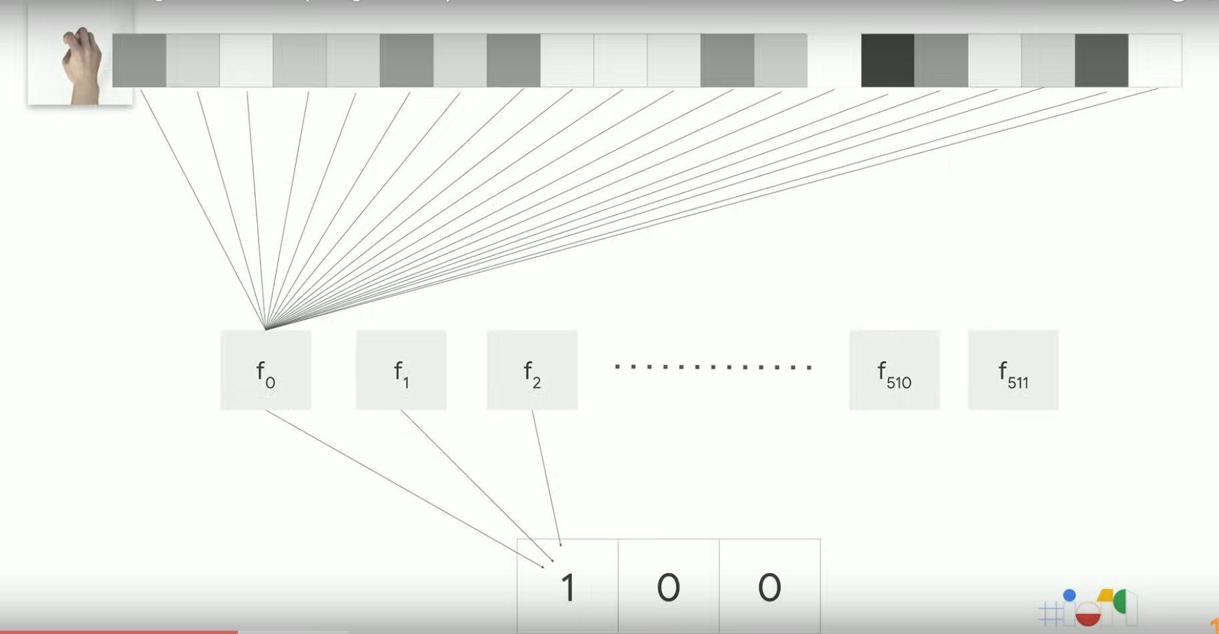
Notes:
Nothing but 512 functions having some internal variables
Initialized with random values
Each function takes in pixel values and map it to the box if it’s a rock

Slide 14
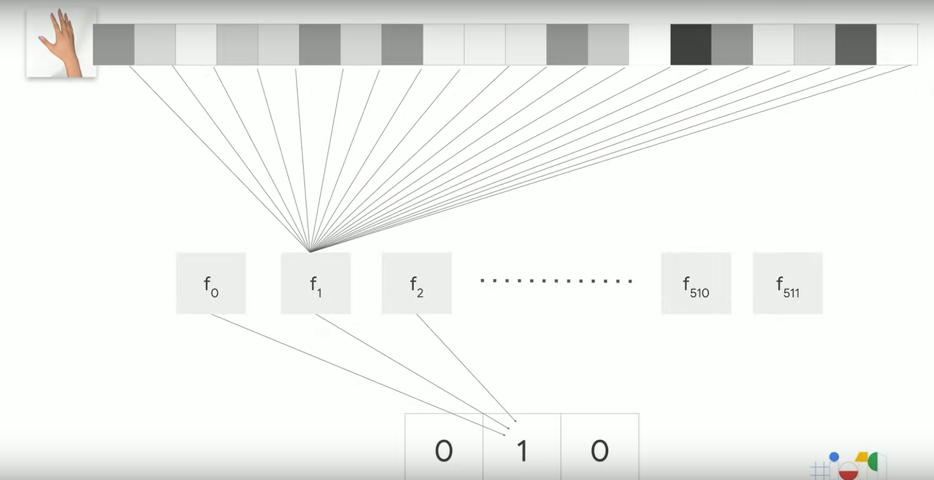
Notes:
Nothing but setting these variables
These are called nothing but parameters.

Slide 15
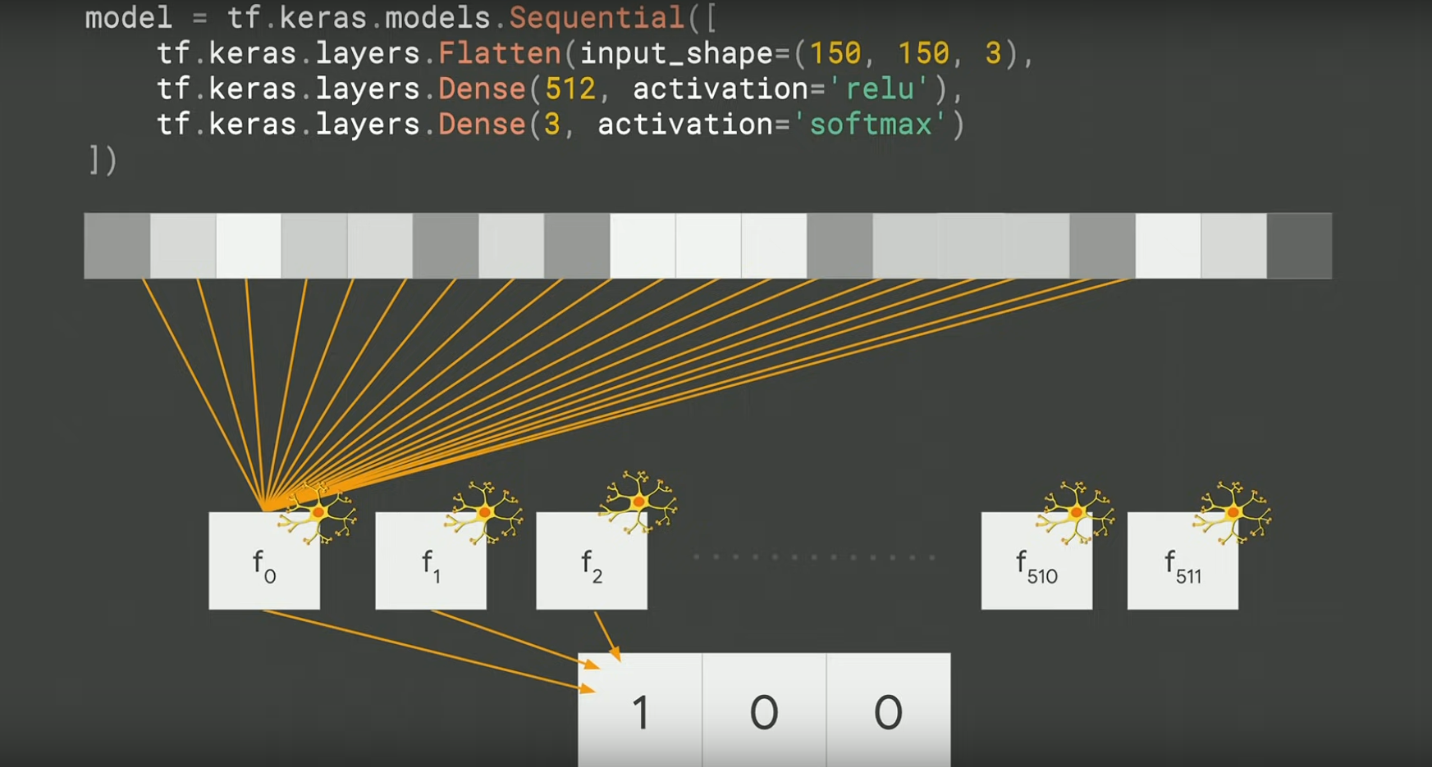
Notes:
Nothing but functions whose values or parameters we are going to learn overtime

Slide 16
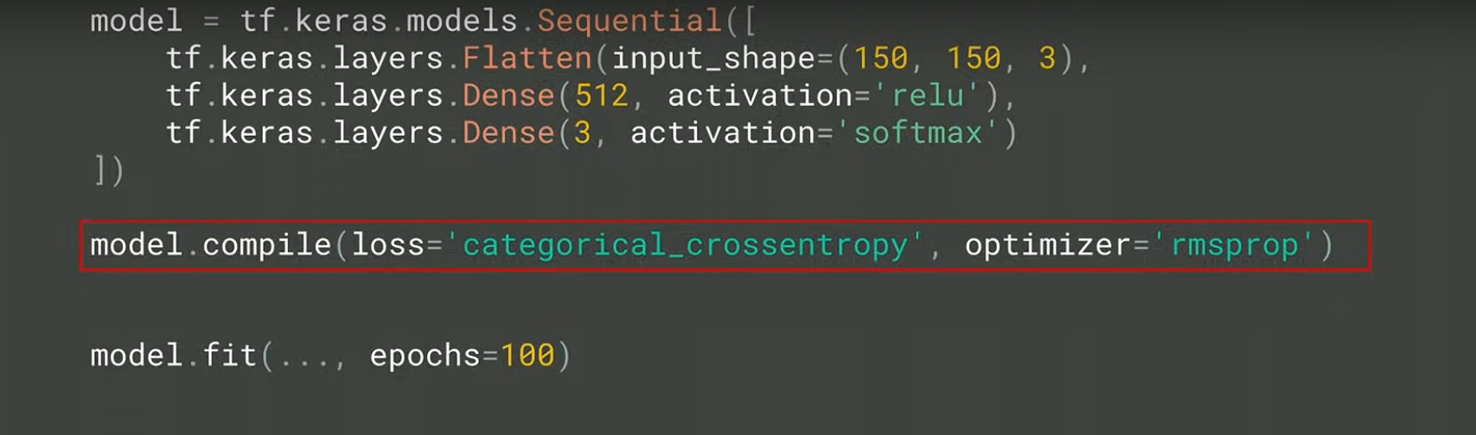
Loss Function – Measures how well or we did? Optimizer – Predict the next guess?
Notes:
Fit keeps on repeating this and we keep moving to the correct output and expect that we will reach there.

Slide 17
What is a perceptron?
A neural network is an interconnected system of perceptron.
Perceptron can be viewed as building blocks in a single layer in a neural network, made up of four different parts:
Input Values or One Input Layer
Weights and Bias
Net sum
Activation function
A neural network, which is made up of perceptron, can be perceived as a complex logical statement (neural network) made up of very simple logical statements (perceptron); of “AND” and “OR” statements.
A statement can only be true or false, but never both at the same time.
The goal of a perceptron is to determine from the input whether the feature it is recognizing is true, in other words whether the output is going to be a 0 or 1.

Slide 18
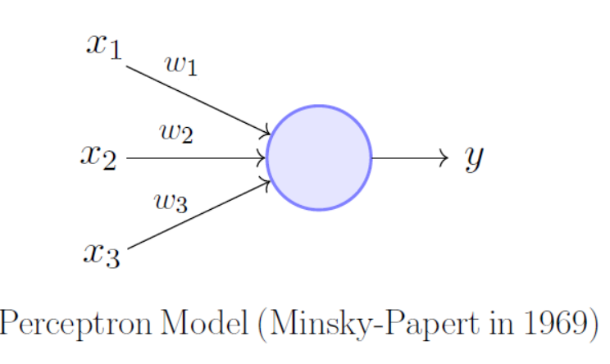
What is a perceptron?

Slide 19
What is a perceptron?
Single perceptron in a layer of a neural network
summing up the weighted inputs (product of each input from the previous layer multiplied by their weight), and adding a bias (value hidden in the circle), will produce a weighted net sum.
The inputs can either come from the input layer or perceptron in a previous layer.
The weighted net sum is then applied to an activation function which then standardizes the value, producing an output of 0 or 1.
This decision made by the perceptron is then passed onto the next layer for the next perceptron to use in their decision.

Slide 20
What is a perceptron?
These perceptrons work together to classify or predict inputs successfully, by passing on whether the feature it sees is present (1) or is not (0).
The perceptrons are essentially messengers, passing on the ratio of features that correlate with the classification vs the total number of features that the classification has.
For example, if 90% of those features exist then it is probably true that the input is the classification, rather than another input that only has 20% of the features of the classification.
It’s just as Helen Keller once said, “Alone we can do so little; together we can do so much.” and this is very true for perceptrons all around.

Slide 21
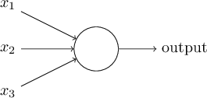


Perceptrons
A perceptron takes several binary inputs, x1,x2,…, and produces a single binary output:
The neuron's output, 0 or 1, is determined by whether the weighted sum is less than or greater than some threshold value .

Slide 22
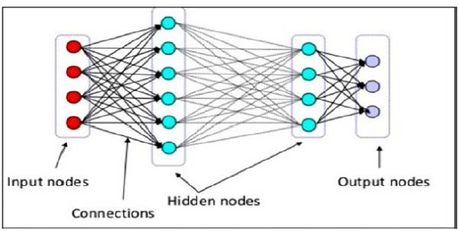
Artificial Neural Network
The network has 3 components
Input layer :
Hidden layer/layers
Output layer

Slide 23
Parts of Neural Network
A neural network has three basic sections or parts:
Input layer
Hidden layer(s)
Output layer
Activation Functions

Slide 24
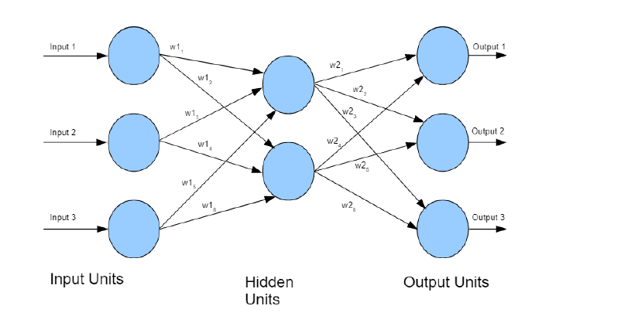

Slide 25
Parts of Neural Network
1
Bias Node
3
Weight
1
Node
6
b2
b1
b1
a1
w1
w5
w2
c1
w3
b2
w6
a2
w4
2
Input layer
4
Hidden layer
5
Output layer

Slide 26
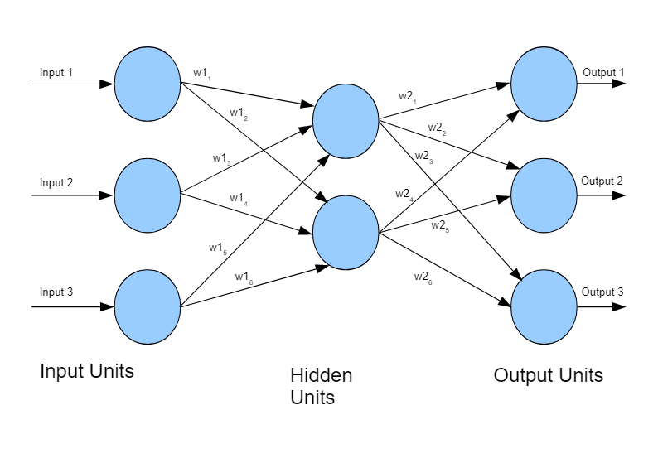
Artificial Neural Network
Input layer : Input units are designed to receive various forms of information from the outside world that the network will attempt to learn about, recognize, or otherwise process and are together referred to as the “Input Layer”. No computation is performed in any of the Input nodes they just pass on the information to the hidden nodes.
Hidden layer/layers : The Hidden nodes have no direct connection with the outside world (hence the name “hidden”). They perform computations and transfer information from the input nodes to the output nodes. A collection of hidden nodes forms a “Hidden Layer”.
Output layer : The Output nodes are collectively referred to as the “Output Layer” and are responsible for computations and transferring information from the network to the outside world.

Slide 27
Input node
An input node contains the input of the network
An input node is located within the input layer, which is the first layer of the neural network
Each input node represents a single dimension and is often called a feature, and all features are stored within a vector
For example if you have an image of 16X16 pixels as input, you have a total of 256 input nodes

Slide 28
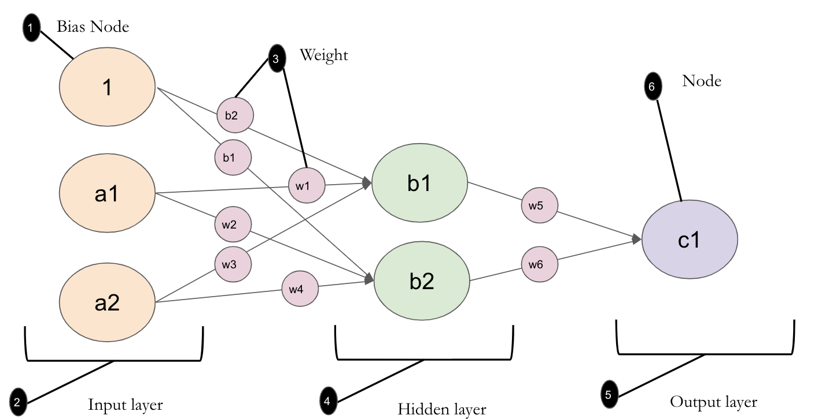
Input node
There are multiple ways to describe an input vector. Some of them are as follows:
Nodes
Features
Dimensions

Slide 29
Input node
Input is always numerical. If the input is not numerical, then by default it is always converted. For example:
Images are always converted to grayscale, and each pixel is measured on a scale of 0 to 1 for intensity
Text is converted to numbers. For example, male/female might be converted to 1 or 0 respectively
Sound is converted to numbers that represent amplitude across time, with 0 (Zero) when silent and 1 when loud

Slide 30
GO TO THE PDF and come back

Slide 31
Hidden Layer
Hidden layer is a layer of nodes between the input and output layers
There can either be a single hidden layer or multiple hidden layers in a network
Multiple hidden layer is what the term deep learning refers to

Slide 32
Hidden Node
A hidden node is a node within a hidden layer
A hidden layer can have many hidden nodes

Slide 33
Output Node

Slide 34
Output node
An output node is a node within an output layer
There can be single or multiple output nodes depending on the objective of the network
For example, if a network exists to classify handwritten digits from 0 to 9, there would be 10 output nodes
Similar to the input of a network, the output is a vector

Slide 35
Weight value
A weight is a variable that sits on an edge between nodes
Weights are important because they are the primary tuning knob that is used to train a network

Slide 36
Weight value
Algorithms are typically used to assign random weights for a neural network
A popular range is between -1 to 1

Slide 37
Bias value
A bias node is an extra node added to the each hidden and output layer, and it connects to every node within each respective layer

Slide 38
Bias value
It typically has a constant value of 1 or -1 and has a weights on its connecting edge
The bias provides every node in a neural network with a trainable constant value ( 1 or -1)

Slide 39
Activation Function
The activation function is a mathematical “gate” in between the input feeding the current neuron and its output going to the next layer
It can be as simple as a step function that turns the neuron output on and off, depending on a rule or threshold
Or it can be a transformation that maps the input signals into output signals that are needed for the neural network to function

Slide 40
Activation Function
Gradually, neural networks use non-linear activation functions, which can help the network learn complex data, compute and learn almost any function representing a question, and provide accurate predictions.

Slide 41
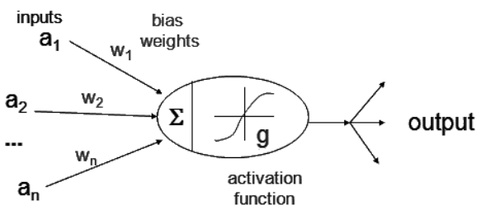
Activation Function

Slide 42
Learning rate
The learning rate is a value that speeds up or slows down how quickly an algorithm learns
It determines the size of step an algorithm takes when moving towards a global minima, i.e., the lowest error rate

Slide 43
Momentum
Momentum is a value that is used to help push a network out of a local minimum. Momentum must be predetermined for the network.

Slide 44
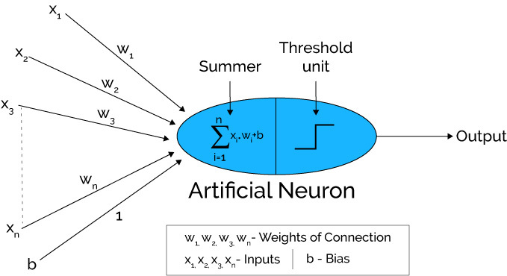
Working of Artificial Neural Network
Input units are passed (x1,x2,x3,…xn) i.e data is passed to the hidden layer with some weights attached to it (w1,w2,w3…wn) . We can have any number of hidden layers .
Each hidden layer consists of neurons . All the inputs are connected to each neuron .
After passing on the inputs , all the computation is performed in the hidden layer .

Slide 45
Working of Artificial Neural Network
Blue portion in the diagram is the hidden layer where all the computations are performed .
Computation is performed in two steps :
Step 1 : First of all , all the inputs are multiplied with their weights . It shows the strength of the particular input . After assigning the weights , a bias variable is added . Bias is a constant that helps the model to fit in the best way possible
Z1 = w1*x1 + w2*x2 + w3*x3 + w4*x4 + w5*x5 + Bias
Step 2 : Then in the second step , Activation function is applied to the linear equation Z1 .
There are several activation functions which will be discussed a little later .

Slide 46
Working of Artificial Neural Network
4. After passing through every hidden layer , we move to the last layer i.e our output layer .
This whole process explained above is known as Forward Propagation .
After getting the predictions from the output layer , the error is calculated i.e. the difference between the actual and the predicted output .
If the error is large , then the steps are taken to minimize the error and for the same purpose Back Propagation is performed.

Slide 47
How neural networks are built?
Neural networks are built using two ways:
Feedforward
Feedback

Slide 48
Feedforward
With feedforward neural network, signals travel only one way, from input to output.
These type of networks are used extensively in pattern recognition
A convolutional neural network (CNN or ConvNet) is a specific type of feedforward network that is often used in image recognition

Slide 49

A multilayer perceptron (MLP) is a class of feedforward artificial neural network. The term MLP is used ambiguously, sometimes loosely to any feedforward ANN, sometimes strictly to refer to networks composed of multiple layers of perceptrons.

Slide 50
Feedback
Feedback is also known as Recurrent Neural Networks
With RNN signals can travel in both directions and there can be loops
Feedback networks are more powerful and complex than CNNs

Slide 51
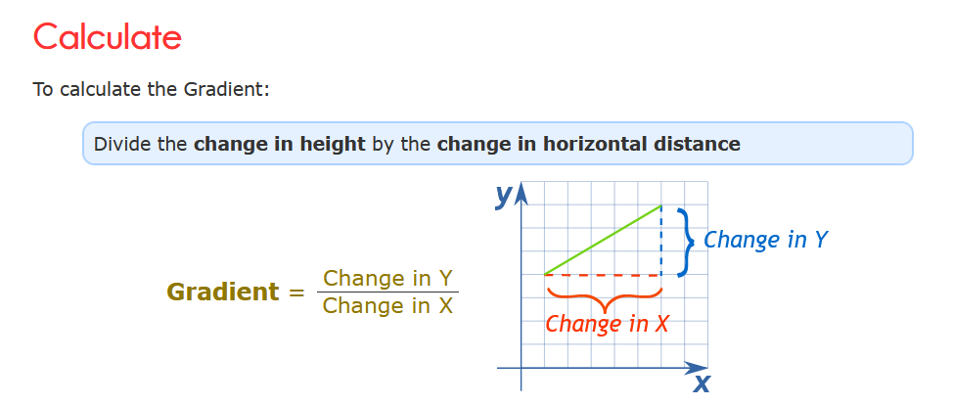
What is GRADIENT(SLOPE)

Slide 52
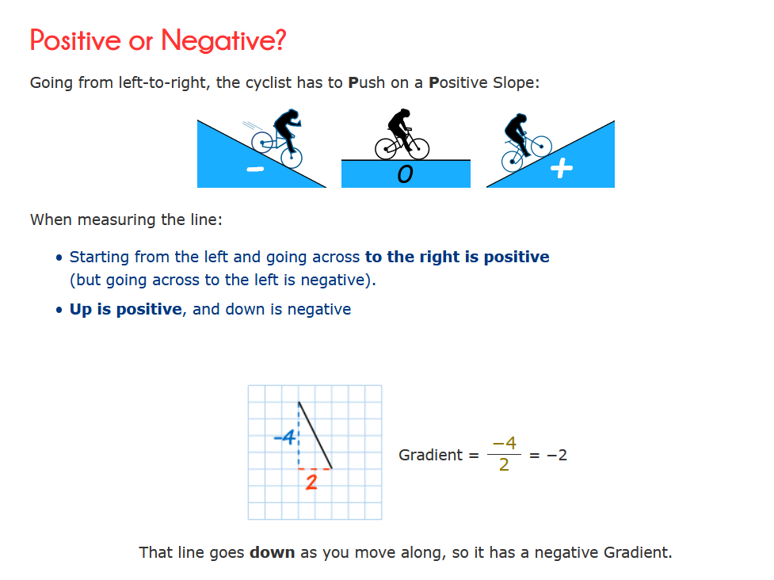
What is GRADIENT(SLOPE)

Slide 53
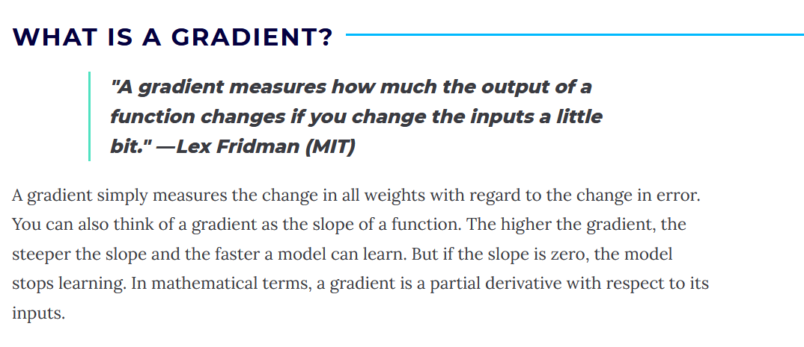
Notes:
EXPLAIN on whiteboard
Imagine a blindfolded man who wants to climb to the top of a hill with the fewest steps along the way as possible.
He might start climbing the hill by taking really big steps in the steepest direction, which he can do as long as he is not close to the top.
As he comes closer to the top, however, his steps will get smaller and smaller to avoid overshooting it.
This process can be described mathematically using the gradient.
Imagine the image below illustrates our hill from a top-down view and the red arrows are the steps of our climber. Think of a gradient in this context as a vector that contains the direction of the steepest step the blindfolded man can take and also how long that step should be.

Slide 54
Gradient Descent
Gradient descent is an optimization algorithm that's used when training a machine learning model.
It's based on a convex function and tweaks its parameters iteratively to minimize a given function to its local minimum.
GO BACK TO PDF

Slide 55
Activation Functions
Activation functions are attached to each neuron and are mathematical equations which determine whether a neuron should be activated or not based on whether the neuron’s input is relevant for the model’s prediction or not .
Various Types of Activation Functions are :
Sigmoid Activation Function
TanH / Hyperbolic Tangent Activation Function
Rectified Linear Unit Function (ReLU)
Leaky ReLU
Soft max

Slide 56
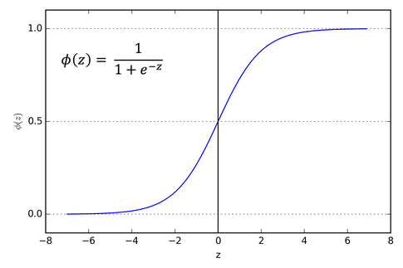
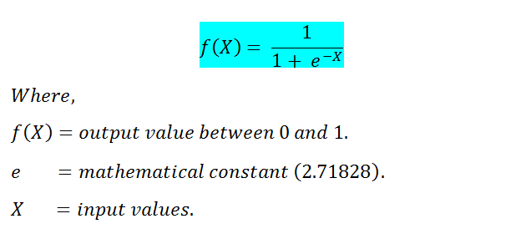
Sigmoid Activation Function
The sigmoid AF is a S shaped curve and its
equation is
The value of the Sigmoid AF lies between 0 to 1 , that is why this is most used for the problems where we need to predict probabilities .

Slide 57


What’s happening inside neural networks?
Defining the scenario
We will build a neural network that will distinguish between two 3 X 3 grayscale pixel characters: Alphabet L or Alphabet T
Neural Network

Slide 58

What’s happening inside neural networks?
Input Layer
Our input layer has a total of 9 input nodes, as you can see in the image below. This is because each pixel becomes a each node in the input layer.
a1
183
22
56
255
.
.
.
255
a2
a3
=
.
.
a9

Slide 59
What’s happening inside neural networks?
Understanding Output Layer
Output layer has two nodes, each node represents a specific class: T or L
c1
=
c2
=

Slide 60
What’s happening inside neural networks?
Understanding Output Layer
Output layer has two nodes, each node represents a specific class: T or L
Neural Network
0
1

Slide 61
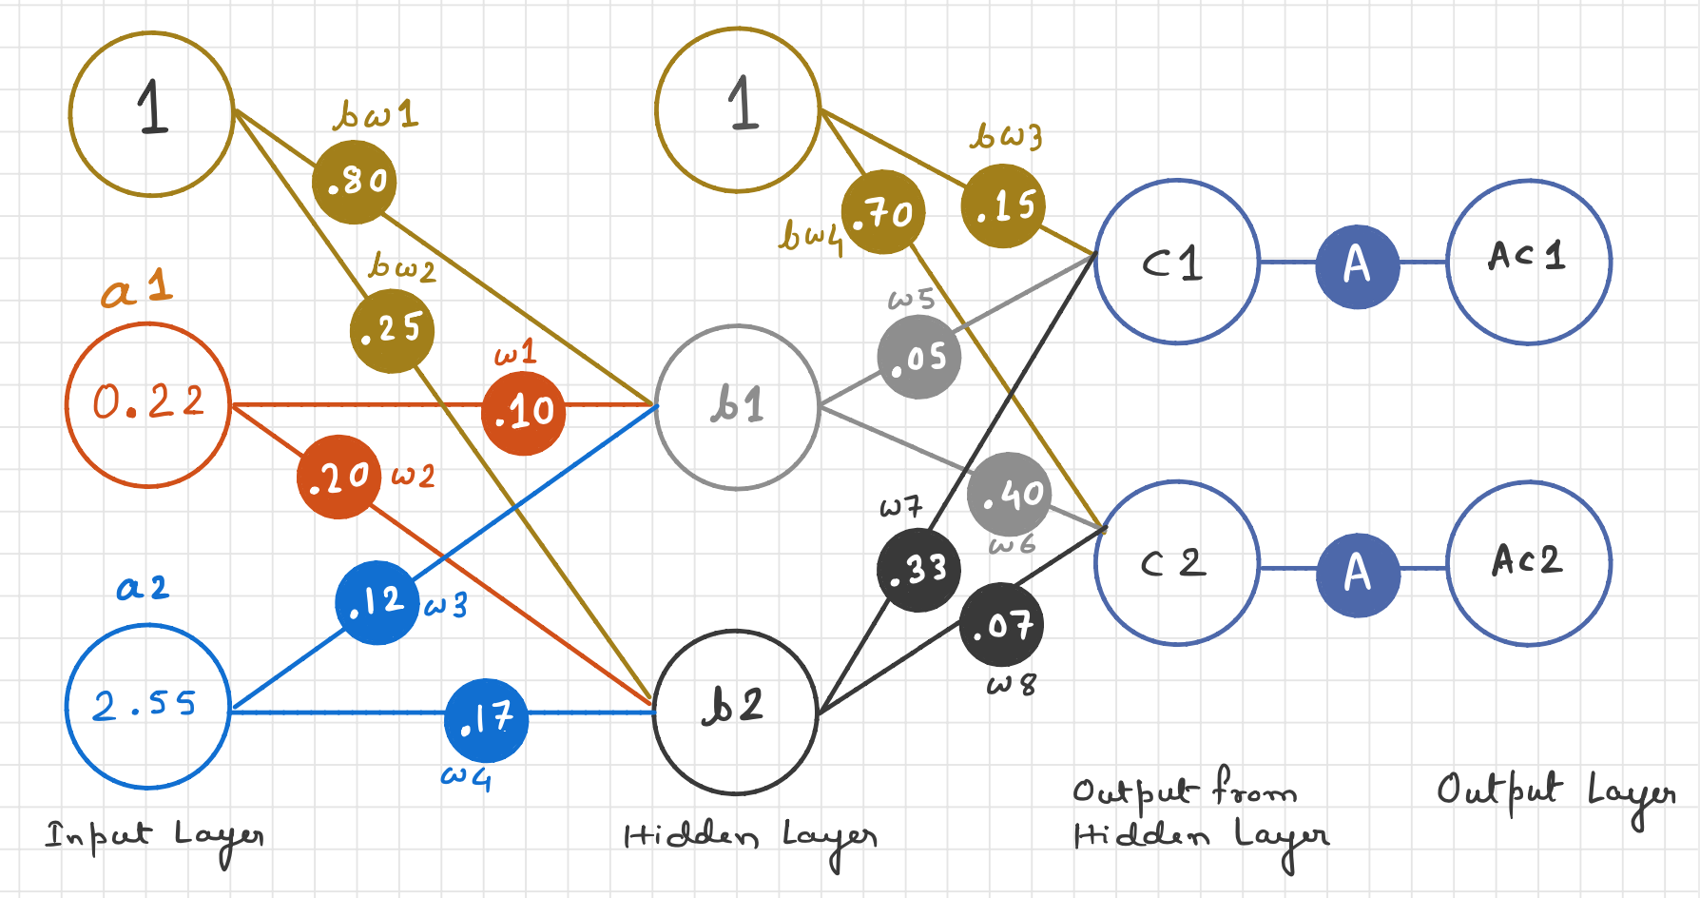
What’s happening inside neural networks?
We will imagine that our image can be classified using only two input nodes and two hidden nodes these inputs have values of 0.22 and 2.55

Slide 62

The first layer of nodes is the input layer, and it doesn’t do anything other than represent the input signals. That is, the input nodes don’t apply an activation function to the input.

Slide 63
What’s happening inside neural networks?
What about the Weights?
What value should they start with? Let’s go with some random weights:
bw​₁ ​= 0.10
bw​₂ ​= 0.25
W​₁ = 0.10
W​₂ ​= 0.20
W​₃​ = 0.12
W​₄ = 0.17

Slide 64
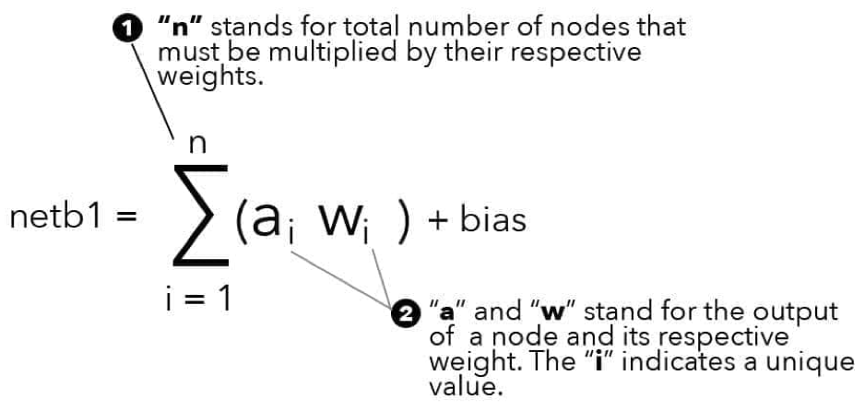
What’s happening inside neural networks?
Moving from Input layer to the Hidden layer
To calculate netb₁ and netb₂, we need to sum all of the inputs into nodes b1 and b2. Using the summation operator, netb1 summation operator looks like below:

Slide 65
What’s happening inside neural networks?
Moving from Input layer to the Hidden layer
netb₁ = (a₁ * w₁) + (a₂ * w₃) + (bias * bw₁)
= (0.22 * 0.10) + ( 2.55 * 0.12)
+(1 * 0.80)
= 0.022 + 0.306 + 0.8
= 1.128
netb₂= (a₁ * w₂) + (a₂ * w₄) + (bias * bw₂)
= (0.22 * 0.20) + ( 2.55 * 0.17)
+(1 * 0.25)
= 0.044 + 0.4335 + 0.25
= 0.7275

Slide 66

What’s happening inside neural networks?
Moving from Input Layer to the Hidden Layer
Let’s see how this looks within our network

Slide 67
What’s happening inside neural networks?
Moving from Hidden Layer to the Output Layer
To calculate netc₁ and netc₂, we need to sum all of the inputs into nodes c1 and c2
netc₁ = (b₁ * w₅) + (b₂ * w₇) + (bias * bw₃)
= (1.1.28 * 0.05) + ( 0.7275 * 0.33) +(1 * 0.15)
= 0.0564 + 0.2400 + 0.15
= 0.4464
netc₂=(b₁ * w₆) + (b₂ * w₈) + (bias * bw₄)
= (1.1.28 * 0.40) + ( 0.7275 * 0.7) +(1 * 0.70)
= 0.4512 + 0.5092 + 0.70
= 1.6604

Slide 68

What’s happening inside neural networks?
Moving from Hidden Layer to the Output Layer
Let’s see how this looks within our network

Slide 69
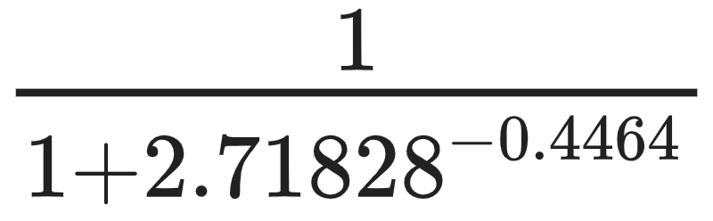
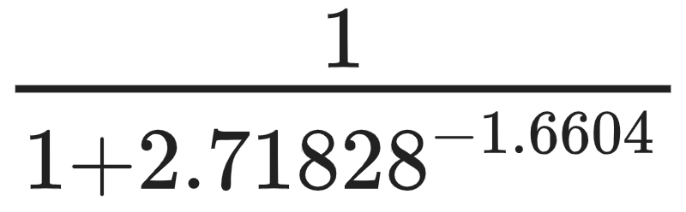
What’s happening inside neural networks?
Applying activation function to the output layer
Apply activation function netc1 and netc2, this will provide us with the final outputs
f(netc₁) =
f(netc₂ ) =
= 0.609782
= 0.8402

Slide 70
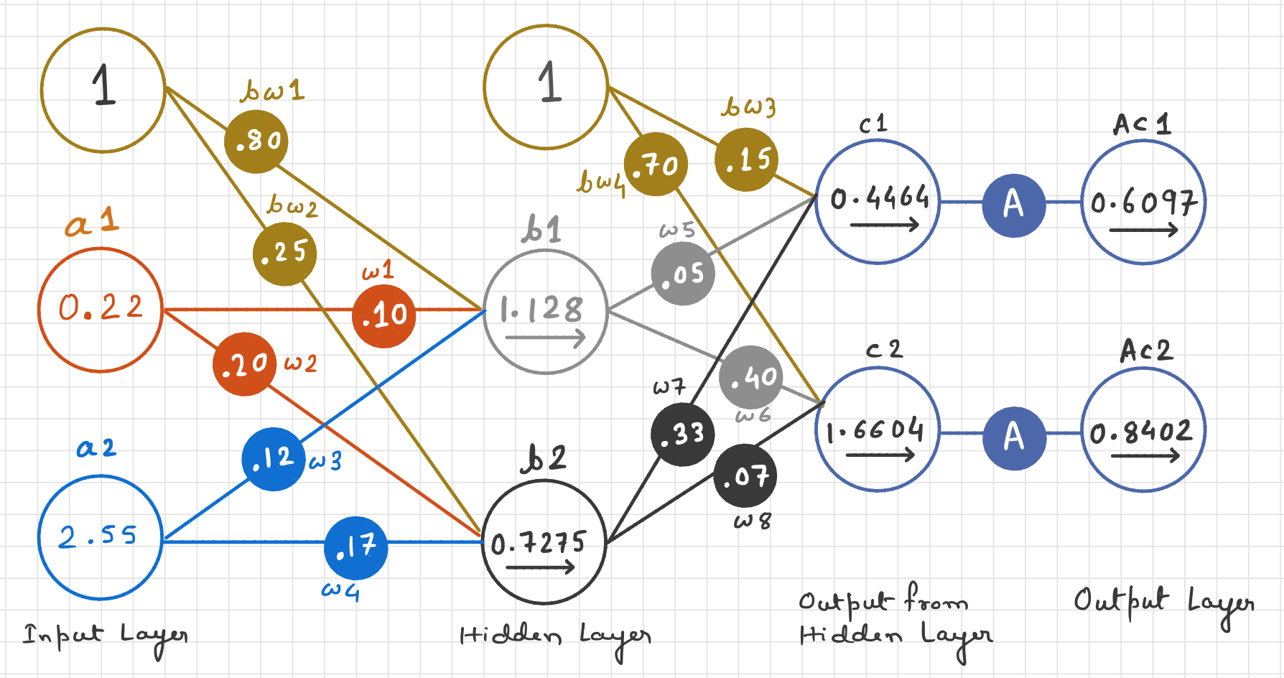
What’s happening inside neural networks?
Moving from Input Layer to the Hidden Layer
Let’s see how this looks within our network

Slide 71
Total Error
We have successfully moved our input through the neural network. Our next step is to compute the total error of the network, which will enable the network to adjust its weights and learn.

Slide 72
What is Total Error?
Total error is the difference between a network’s actual output and the target output

Slide 73
Error/Cost function is often referred to as an objective function. This is because the objective of the network is to minimize the cost function.

Slide 74
Cost Function
Types of Cost Functions
There are many types of cost functions. Few of them are:
Mean squared error
Squared error
Root mean squared error
Sum of squared errors

Slide 75
Cost Function
Types of Cost Functions
Some other cost functions include:
Cross entropy
Exponential
Hellinger Distance
Kullback-Leibler Divergence

Slide 76
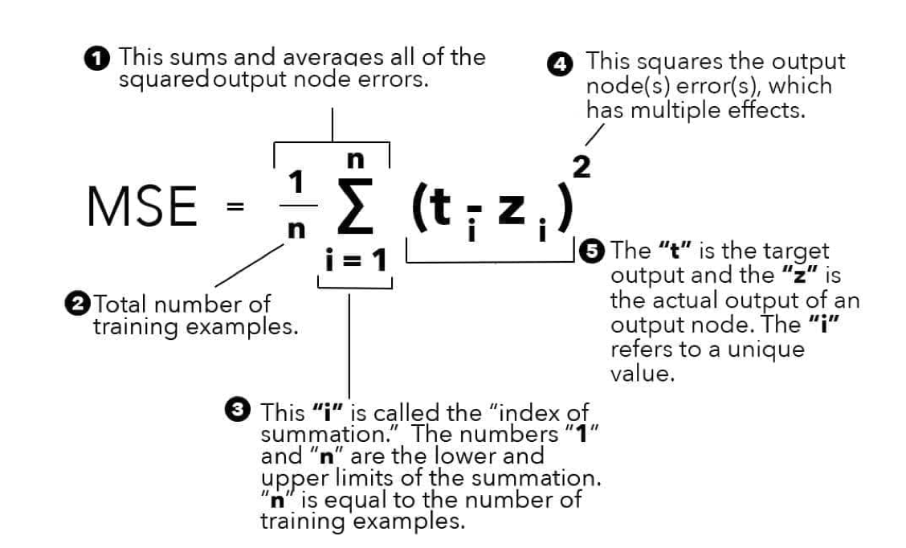
Mean Squared Error
MSE
The MSE measures the difference between the target output and actual output of training examples in a network

Slide 77
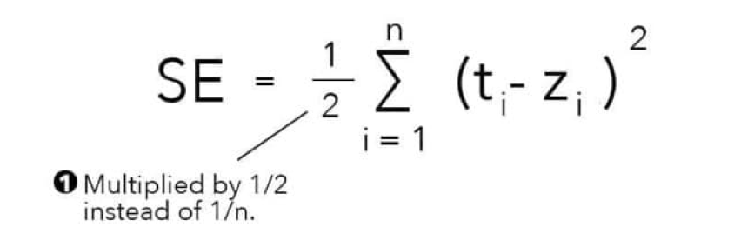
Squared Error
SE
The squared error function is identical to the MSE except it is multiplied by ½, not 1/n

Slide 78
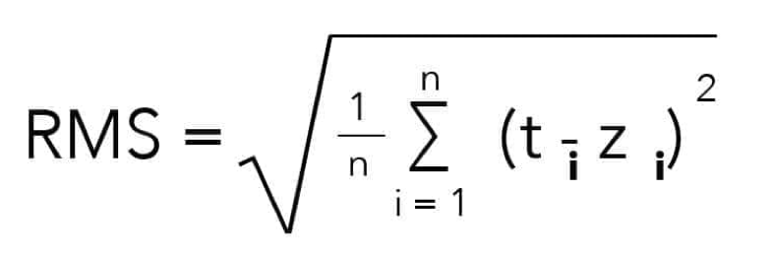
Root Mean Square
RMS
The root mean square performs the same calculations as the MSE, with the only difference being that it squares the answer
Note: Elements are not labelled because they are exactly same as in the MSE equation

Slide 79
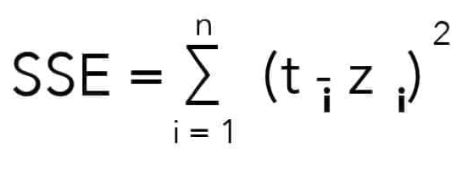
Sum of Squared Errors
SSE
The SSE function is similar to the MSE, with the only difference being that the answer is not being averaged by n number of training examples
Note: Elements are not labelled because they are exactly same as in the MSE equation

Slide 80
What’s happening inside neural networks?
Calculating the Total Error
We will compare the actual output of the network to the target output of the network, our target output is a vector with a value of 0(zero) for the node c1 and value of 1(one) for node c2
0
1
=

Slide 81
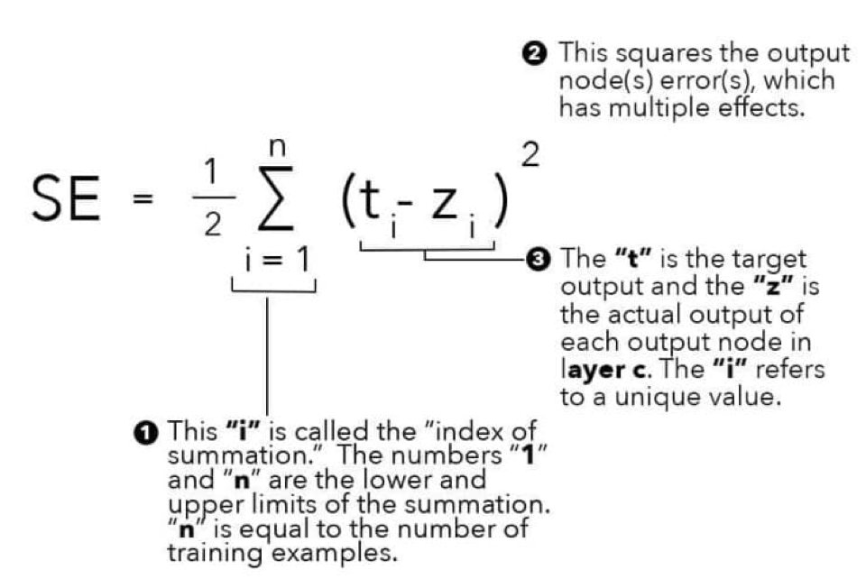
What’s happening inside neural networks?
Calculating the Total Error
To calculate the error we need to apply a cost function to each output node and then sum the answers together, we will use the squared sum error (SE) function

Slide 82
What’s happening inside neural networks?
Calculating the Total Error
Calculating the total error for node c1 and nodec2
SEc₁ = (0 - 0.6097)²
= 0.3717
SEc₂ = (0 - 0.8402)²
= 0.7059
Since we are dealing with only one training example
SE = ½ * 1.0779
= 0.53895

Slide 83
What’s happening inside neural networks?
Calculating the Total Error
Node local error
0.3717
Node local error
0.7059
Total error
0.53895

Slide 84
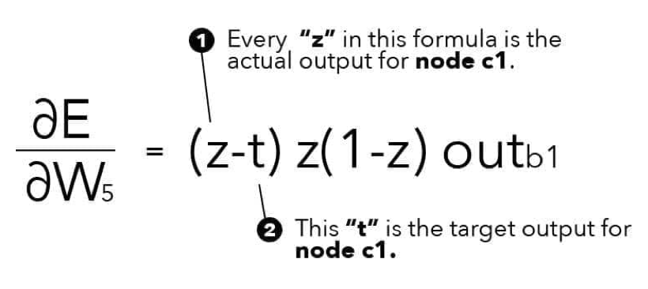
What’s happening inside neural networks?
Calculating the Gradients
We have calculated our total error, now begin back propagation
Calculating the gradients with respect to W₅
Note that the “t” and “z” in the equation only apply the node c₁. This is because W₅ effects the only node c₁.

Slide 85
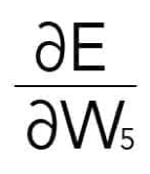
What’s happening inside neural networks?
Calculating the Gradients
Substituting our values, we get the following:
= (z-t)z(1-z) outb₁
= (0.6097-0)0.6097(1-0.6097)*(1.128)
= 0.6097*0.2379*1.28
= 0.1856

Slide 86
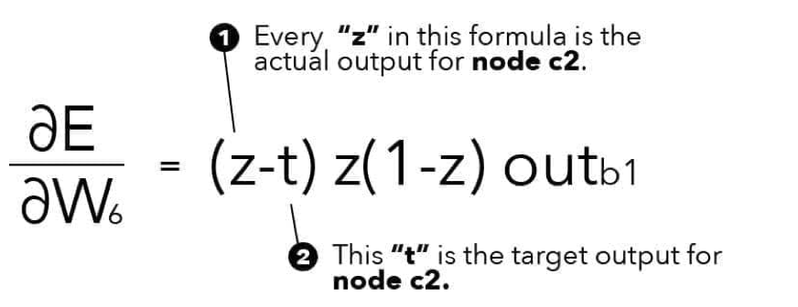
What’s happening inside neural networks?
Calculating the Gradients
Calculating the gradients with respect to W₆
= (z-t)z(1-z) outb₁
= (0.8402-1)0.8402(1-0.8402)*(1.128)
= -0.1598*0.134*1.28
= -0.02415

Slide 87
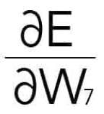

What’s happening inside neural networks?
Calculating the Gradients
Calculating the gradients with respect to W₇ and W₈
= (z-t)z(1-z) outb₁
=(0.6097-0)0.6097(1-0.6097)*(0.6097)
= 0.6097*0.23796*0.6097
= 0.0884
= (z-t)z(1-z) outb₁
=(0.8402-1)0.8402(1-0.8402)*(0.8402)
= -0.1598*0.13426*0.8402
= -0.01802

Slide 88
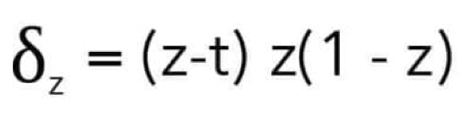
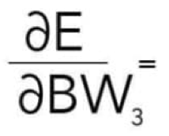
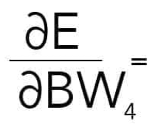
What’s happening inside neural networks?
Calculating the gradients for output layer bias weights
The gradient of any output layer bias weight is simply deltaz:
(z-t)z(1-z)
= (0.6097-0)0.6097(1-0.6097)
= 0.6097*0.6097*0.3903
= 0.14508
(z-t)z(1-z)
= (0.8402-1)0.8402(1-0.8402)
= - 0.1598*0.8402*0.1598
= -0.02145

Slide 89
What’s happening inside neural networks?
Finally! We have now finished calculating the gradients(partial derivatives) for each weight connected to the output layer. Let’s move forward and begin the calculating the hidden layer weights

Slide 90
What’s happening inside neural networks?
Calculating for W₁
Let’s begin by calculating the part 1 of the formula
For node C₁
δ_{z}= (z-t) z(1-z)
δ_{z}= 0.14508
Therefore, all we need to do is multiply by W₅
0.14508* 0.05
0.00725

Slide 91
What’s happening inside neural networks?
Calculating for W₁
Let’s begin by calculating the part 1 of the formula
For node C₂
δ_{z}= (z-t) z(1-z)
δ_{z}= -0.02145
Therefore, all we need to do is multiply by W₅
-0.02145* 0.40
-0.00858

Slide 92

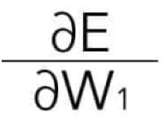
What’s happening inside neural networks?
Calculating for W₁
Now we can implement the summation operator and add the two values together
= 0.00725+(-0.00858)
= -0.00133
Part 1 of the formula is now complete, we will calculate step 2 and 3
Step 2:
Step 3:
= -0.00133*-0.14438*0.22
= 0.00004225
= 1.1.28(1 - 1.1.28)
= -0.14438

Slide 93
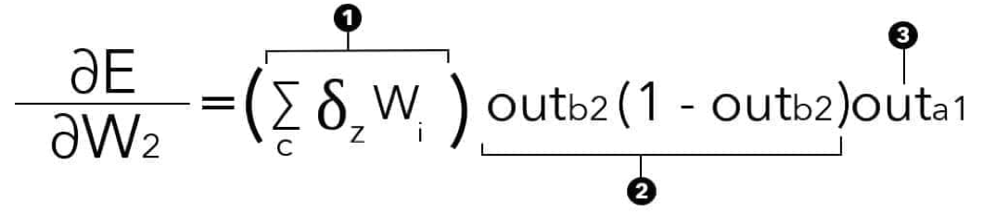
What’s happening inside neural networks?
Calculating for W₂
Let’s begin by calculating the part 1 of the formula
For node C₁
Part 1:
Therefore, all we need to do is multiply by W₇
δ_{z}= (z-t) z(1-z)
= 0.14508* 0.33
δ_{z}= 0.14508
= 0.04785

Slide 94
What’s happening inside neural networks?
Calculating for W₂
Let’s begin by calculating the part 1 of the formula
For node C₂
δ_{z}= (z-t) z(1-z)
δ_{z}= -0.02145
Therefore, all we need to do is multiply by W₇
= - 0.02145* 0.07
= - 0.0015015

Slide 95
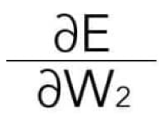
What’s happening inside neural networks?
Calculating for W₂
Now we can implement the summation operator and add the two values together
= 0.0478+(-0.0015)
= -0.0463
Part 1 of the formula is now complete, we will calculate step 2 and 3
Step 2:
Step 3:
= -0.0463*0.1982*0.22
= -0.002018
= 0.7275(1 - 0.7275)
= 0.19824

Slide 96
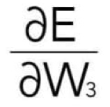
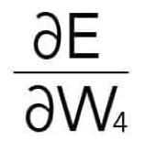
What’s happening inside neural networks?
Calculating for W₃ and W₄
Calculating for W₃ : Notice that this calculation is almost identical to W₁. The only difference is replacing outa₁ with outa₂
Calculating for W₄ : Notice that this calculation is almost identical to W₂. The only difference is replacing outa₁ with outa₂
= (-0.00133)(-0.14438)(0.35)
= 0.00006721
= (-0.0463)(0.1982)(0.35)
= -0.00321183

Slide 97
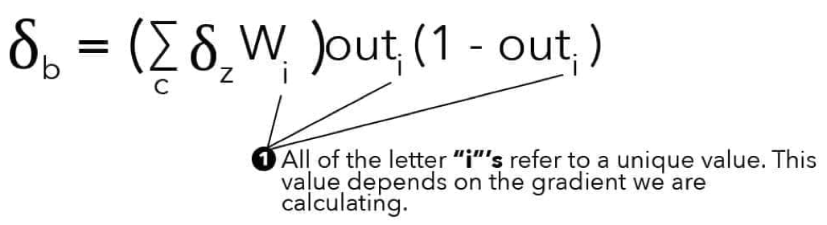
What’s happening inside neural networks?
Calculating gradients for hidden layer bias weights
The gradient of any hidden layer bias weight is simply the Deltab of the previous layer

Slide 98
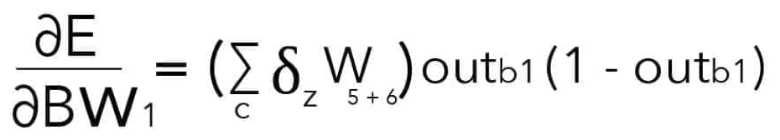
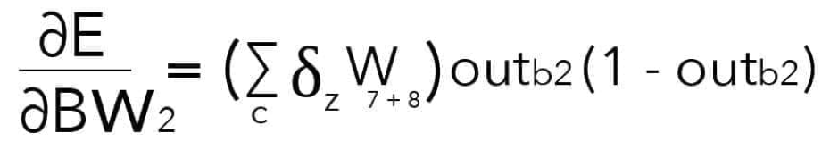
What’s happening inside neural networks?
Calculating gradients for hidden layer bias weights
= (-0.00133)1.128(1-1.1.28)
= 0.00019203
= (0.04785)0.7275(1-0.7275)
= 0.00948596

Slide 99
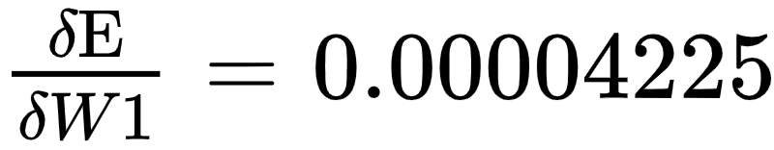
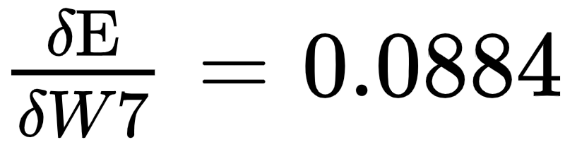










What’s happening inside neural networks?
Total gradients calculated

Slide 100

What’s happening inside neural networks?
Updating weights
We will begin by updating weight W₈. You will notice within the formula that it does not include momentum. We have omitted this for the sake of easy calculation.

Slide 101




What’s happening inside neural networks?
Updating weight W₈, W₇, W₆, and W₅
To update weight, we will substitute our values into the formula
= 0.07-0.5 (-0.01802)
= 0.07901
= 0.40-0.5(-0.02415)
= 0.412075
= 0.33-0.5 (0.884)
= 0.2858
= 0.05-0.5 (0.1856)
= -0.0428

Slide 102




What’s happening inside neural networks?
Updating weight W₄, W₃, W₂, and W₁
To update weight, we will substitute our values into the formula
= 0.17-0.5 (-0.00321183)
= 0.1716055
= 0.20-0.5(-0.00201887)
= 0.20100944
= 0.12-0.5 (0.00006721)
= 0.1199664
= 0.10-0.5 (0.00004225)
= 0.09997888

Slide 103




What’s happening inside neural networks?
Updating bias weights
To update the bias weights we apply the same formula
= 0.70-0.5 (-0.02145)
= 0.710725
= 0.25-0.5(0.009485)
= 0.2452575
= 0.15-0.5 (0.14508)
= 0.07746
= 0.80-0.5 (0.00019203)
= 0.79990398

